Slide 1
Toán Rời Rạc
(c)2001-2004, Michael P. Frank

Slide 2
Toán học trên thực tế là gì?
Đây không phải chỉ về các số!
Toán học thực tế nhiều hơn thế:
Nhưng, những khái niệm này có thể là về các con số, ký hiệu, đối tượng, hình ảnh, âm thanh hay bất cứ cái gì khác!
Toán học, nói tổng quát, là nghiên cứu về mọi chân lý đúng tuyệt đối về mọi khái niệm được định nghĩa một cách đúng đắn.
(c)2001-2004, Michael P. Frank
Notes:
Discrete Math - Module #0 - Overview
(c)2001-2003, Michael P. Frank
As you may have already concluded from the title of the textbook, this is a course about mathematics. But, it is a type of mathematics that may be unfamiliar to you. You may have concluded from your exposure to math so far that mathematics is primarily about numbers. But really, that’s not true at all. The essence of mathematics is just the study of formal systems in general. A formal system is any kind of entity that is defined perfectly precisely, so that there can be no misunderstanding about what is meant. Once such a system has been set forth, and a set of rules for reasoning about it has been laid out, then, anything you can deduce about that system while following those rules is an absolute certainty, within the context of that system and those rules. Number systems aren’t the only kinds of system that we can reason about, just one kind that is widely useful. For example, we also reason about geometrical figures in geometry, surfaces and other spaces in topology, images in image algebra, and so forth.
Any time you precisely define what you are talking about, set forth a set of definite axioms and rules for some system, then it is by definition a mathematical system, and any time you discover some unarguable consequence of those rules, you are doing mathematics.
In this course, we’ll encounter many kinds of perfectly precisely defined (and thus, by definition, mathematical) concepts other than just numbers. You will learn something of the richness and variety of mathematics. And, we will also teach you the language and methods of logic, which allow us to describe mathematical proofs, which are linguistic presentations that establish conclusively the absolute truth of certain statements (theorems) about these concepts.
In a sense, it’s easy to create your own new branch of mathematics, never before discovered: just write down a set of axioms and inference rules, make sure their meanings are perfectly clear, and then work out their consequences. Whether anyone else finds your new area of mathematics particularly interesting is another matter. The areas of math that have been thoroughly explored by large numbers of people are generally ones that have a large number of applications in helping to understand some other subject, whether it be another area of mathematics, or physics, or economics, biology, sociology, or whatever other field.
See http://mathworld.wolfram.com/ for a survey of some other areas of mathematics, to show you just how much there is to mathematics, besides just numbers!

Slide 3
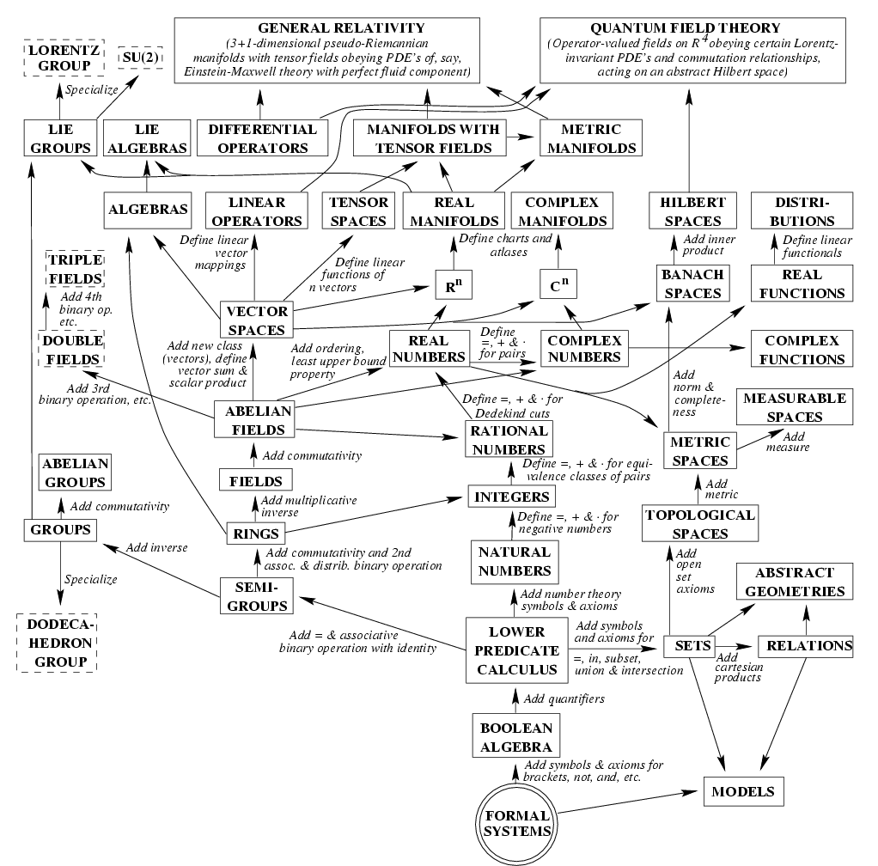
Physics from Mathematics
Starting from simple structures of logic & set theory,
  Mathematics builds up structures that include all the complexity of our physical universe…
    Except for a few “loose ends.”
One theory of philosophy:
  Perhaps our universe is nothing other than just a complex mathematical structure!
    It’s just one that happens to include us!
From Max Tegmark, ‘98
(c)2001-2004, Michael P. Frank

Slide 4
Vậy môn học này dạy về cái gì?
Cấu trúc “rời rạc” là cái gì?
“Discrete” - rời rạc gồm các phần riêng biệt. (Đối nghịch với liên tục)
rời rạc:liên tục :: kỹ thuật số:tương tự
“Cấu trúc” – Các đối tượng được xây dựng từ các đối tượng đơn giản hơn nhờ các mẫu xác định.
“Toán rời rạc” – nghiên cứu về các cấu trúc và đối tượng toán học rời rạc.
(c)2001-2004, Michael P. Frank
Notes:
Discrete Math - Module #0 - Overview
(c)2001-2003, Michael P. Frank
The title of this course (at UF) is “Applications of Discrete Structures.” Actually that title is misleading. Although discrete math has many applications, which we’ll survey in a moment, this class is not really about applications so much as it is about basic mathematical skills and concepts. My guess is that the only reason we call the course “Applications of Discrete Structures” rather than just “Discrete Mathematics” so that the people over in the Math department don’t get upset that we’re teaching our own basic math course over here, rather than leaving it to them.
Anyway, that issue aside, you may be wondering, what is a “discrete structure” anyway? Well, by “discrete” we don’t mean something that’s kept secret – that’s “discreet” with a double-e, a homonym, a completely different English word with a completely different meaning. No, our word “discrete” just means something made of distinct, atomic parts, as opposed to something that is smooth and continuous, like the curves you studied in calculus. Later in the course we’ll learn how to formalize this distinction more precisely using the concepts of countable versus uncountable sets. But for now, this intuitive concept suffices.
By “structures” we just mean objects that can be built up from simpler objects according to some definite, regular pattern, as opposed to unstructured, amorphous blobs. In this course, we’ll see how various types of discrete mathematical objects can be built up from other discrete objects in a well-defined way.
The field of discrete mathematics can be summarized as the study of discrete, mathematical (that is, well-defined, conceptual) objects, both primitive objects and more complex structures.

Slide 5
Mối quan hệ giữa các cấu trúc
“→” :≝ “Can be defined in terms of”
Groups
Programs
Proofs
Trees
Complex
numbers
Operators
Propositions
Graphs
Real numbers
Strings
Functions
Integers
Relations
Matrices
Natural
numbers
Sequences
Infinite
ordinals
Bits
n-tuples
Vectors
Sets
Not all possibilities
are shown here.
(c)2001-2004, Michael P. Frank
Notes:
Discrete Math - Module #0 - Overview
(c)2001-2003, Michael P. Frank
As I mentioned earlier, mathematical structures can often be built up or defined in terms of simpler structures. This diagram (which itself is an example of the type of discrete structure known as a “graph”) outlines some ways in which a variety of discrete (and continuous) structures can ultimately be built up from a very simple type of discrete structure known as a set, which is one of the first structures we will learn. This is just to give you a a bit of a feel for the inter-relatedness of mathematical objects. This diagram is vastly simplified; some of the dependencies are left out, many other kinds of structures and ways of defining structures in terms of other structures are also possible and are left out for simplicity. For example, sets themselves can be defined in terms of functions, or relations. No one type of structure is truly fundamental, since almost any structure can be defined in terms of almost any other. Sets are only one possible starting point; but they are a popular one because their definition is so simple. We will revisit this diagram in more detail throughout this course, and show how the various links work.

Slide 6
Tại sao phải học Toán rời rạc?
Cơ sở của mọi quá trình xử lý thông tin kỹ thuật số là: Thao tác rời rạc của các cấu trúc rời rạc trong bộ nhớ.
Là ngôn ngữ cơ bản và khái niệm cơ sở cho mọi thức khác của Khoa học máy tính.
Các khái niệm toán rời rạc được dùng rộng rãi trong Toán học, Khoa học, Công nghệ, Kinh tế, Sinh học, …
Là công cụ có ích nói chung cho mọi suy nghĩ hợp lý!
(c)2001-2004, Michael P. Frank

Slide 7
Ứng dụng của Toán rời rạc trong
Khoa học máy tính
Cấu trúc dữ liệu và giải thuật
Chương trình dịch.
Mạng máy tính Computer networks
Hệ điều hành Operating systems
Kiến trúc máy tính Computer architecture
Hệ quản trị cơ sở dữ liệu
Mã hoá-Cryptography
Lập trình chỉnh lỗi Error correction codes
Cơ chế trò chơi, thuật toán mô phỏng và đồ họa…
Mọi lĩnh vực!
(c)2001-2004, Michael P. Frank

Slide 8
Mục đích môn học
Học xong môn này sinh viên có thể:
  Lập luận các suy luận logic đơn giản (chứng minh).
  Kiểm tra tính đúng đắn của các thuật toán đơn giản.
  Tự xây dựng các suy luận và các thuật toán đúng đắn.
  Mô tả các định nghĩa và các tính chất của nhiều kiểu cấu trúc dữ liệu rời rạc.
  Hiểu, biểu diễn và phân tích đúng đắn nhiều kiểu cấu trúc dữ liệu rời rạc sử dụng các khái niệm chuẩn
Think!
(c)2001-2004, Michael P. Frank
Notes:
Discrete Math - Module #0 - Overview
(c)2001-2003, Michael P. Frank
This summarizes the course objectives. The syllabus goes into this in more detail. The most important objective (in my opinion) is that after taking this course (if not before), the student should be capable of performing logical thought and reasoning that is creative, yet precise and correct. Working with specific kinds of discrete structures is a good way to practice this skill, and the knowledge gained is useful due to the widespread use of these structures.

Slide 9
Kế hoạch học tập
Chương 1: Logic cơ sở (4 tuần)
Chương 2: Phương pháp đếm (4 tuần)
Chương 3: Lý thuyết đồ thị (4 tuần)
Chương 4: Lý thuyết quan hệ (4 tuần)
(c)2001-2004, Michael P. Frank

Slide 10
Đánh giá học phần
Mỗi tuần có 3 tiết lý thuyết, 3 tiết chữa bài tập.
Điểm Học phần = 30% điểm thành phần + 70% điểm thi cuối kỳ
Điểm thành phần : Kiểm tra giữa kỳ (Kiểm tra tự luận trên giấy 1 tiết) + điểm thưởng +chuyên cần
Điểm cuối kỳ: Thi viết gồm 4 câu tự luận + điểm thưởng.
Điểm thưởng: chữa bài tập trên lớp, phát biểu ý kiến…
(c)2001-2004, Michael P. Frank

Slide 11
Tài liệu tham khảo
Toán học ứng dụng trong tin học (Keneth H.Rossen)
Toán rời rạc (Chủ biên Nguyễn Văn Long, khoa CNTT, đại học GTVT)
Toán rời rạc ( Nguyễn Đức Nghĩa – Nguyễn Tô Thành, đại học Bách Khoa)
(c)2001-2004, Michael P. Frank

Slide 12
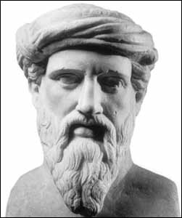
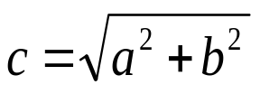
A Proof Example
Theorem: (Pythagorean Theorem
of Euclidean geometry) For any
real numbers a, b, and c, if a and b are the base-length and height of a right triangle, and c is the length of its hypo-
tenuse, then a² + b² = c².
Proof: See next slide.
Pythagoras of Samos
(ca. 569-475 B.C.)
b
a
(c)2001-2004, Michael P. Frank
Notes:
Discrete Math - Module #0 - Overview
(c)2001-2003, Michael P. Frank
One of the most important (and most difficult) skills you will (hopefully) learn in this course is the ability to verify the correctness of logical and mathematical proofs, and even (at least in simple cases) to come up with such proofs on your own. In case you’ve never seen a formal proof before, here is one easy example, to give you some of the flavor of what we’ll be doing.
What is a proof? It is a logically valid argument that indisputably establishes the perfect, undeniable and absolute truth of a theorem (within the context of its premises).
You may remember the Pythagorean Theorem from your geometry, analytic geometry, trigonometry, or calculus classes. Actually this theorem is not really original with Pythagoras; it was known to the ancient Egyptian civilization, where it was used to construct perfect right angles for building the pyramids. (It may have been known by even earlier civilizations.) However, back then they just observed that the theorem was true for specific cases, and did not really offer what in modern times we think of as a general proof of the statement. Anyway, the theorem says simply that for any right triangle (in any Euclidean – that is, flat – geometrical space), if a and b are the perpendicular side lengths, and c is the length of the hypotenuse, then a²+b²=c². You have probably known this theorem for years. But, do you know how to prove it?

Slide 13
Proof of Pythagorean Theorem
Proof. Consider the below diagram:
  Exterior square area = c², the sum of the following regions:
    The area of the 4 triangles = 4(½ab) = 2ab
    The area of the small interior square = (b−a)² = b²−2ab+a².
  Thus, c² = 2ab + (b²−2ab+a²) = a² + b². ■
c
Note: It is easy to show that the exterior and interior quadrilaterals in this construction are indeed squares, and that the side length of the internal square is indeed b−a (where b is defined as the length of the longer of the two perpendicular sides of the triangle). These steps would also need to be included in a more complete proof.
½ab
a
c
b
b
a
(b−a)²
½ab
½ab
b
a
c
b
a
½ab
c
Areas in this diagram are in boldface; lengths are in a normal font weight.
(c)2001-2004, Michael P. Frank

Slide 14
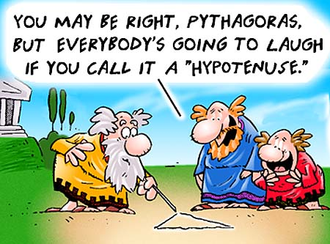
Finally: Have Fun!
(c)2001-2004, Michael P. Frank

